Slide 1
Lesson 6
Tic Tac Toe . Temperature Conversion . Project 1

Slide 2
Lesson objectives
Tic Tac Toe
Temperature Conversion Program
Release of Project 1

Slide 3
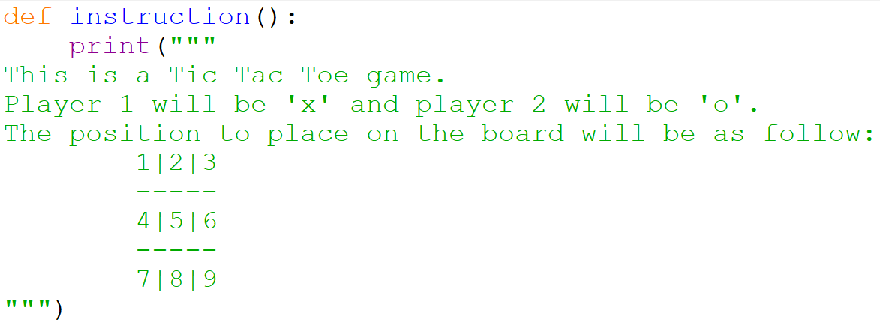
Creating Tic Tac Toe - instruction

Slide 4
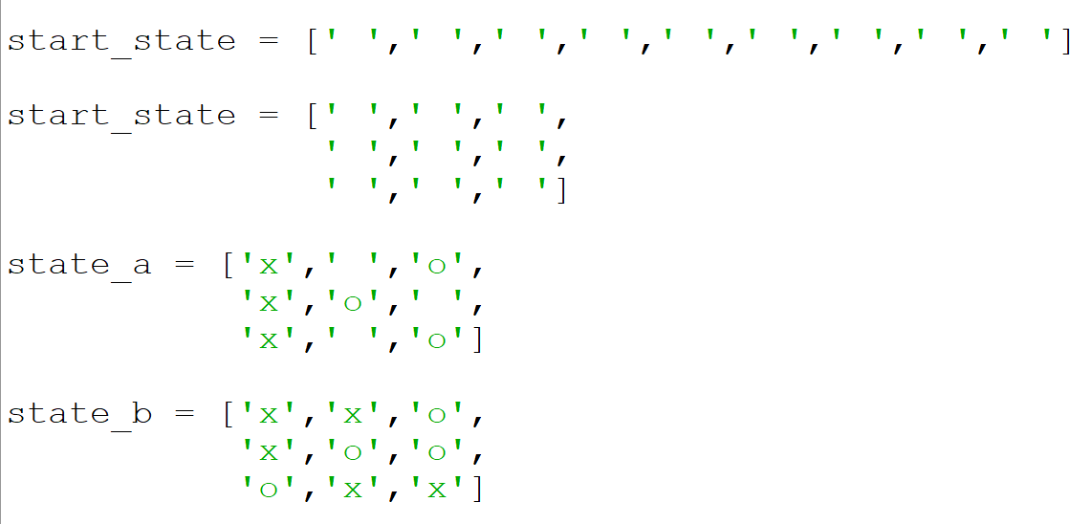
How to represent the state of game ?
use a list to represent the state of the game
this is a better format to express the state

Slide 5
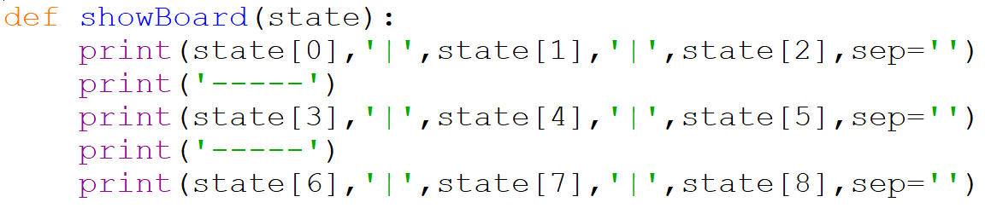
Creating Tic Tac Toe – show board

Slide 6
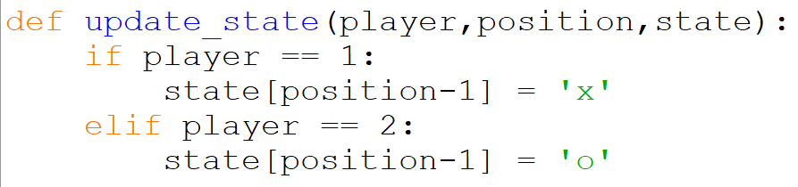
Creating Tic Tac Toe – update state

Slide 7
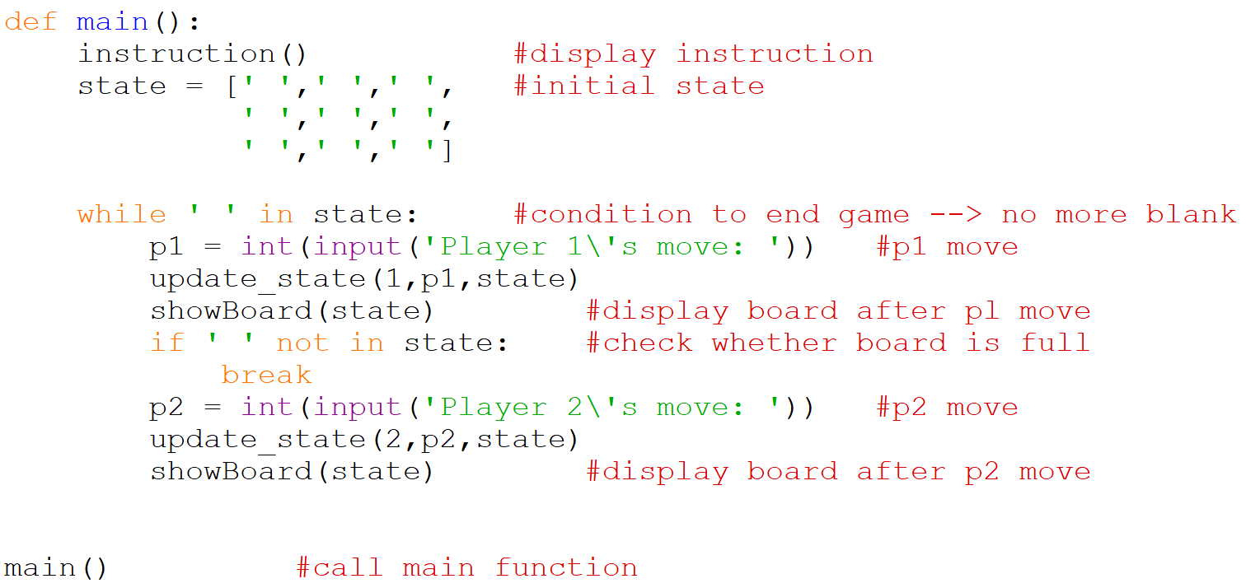
Creating Tic Tac Toe – main function

Slide 8
Assignment : Tic Tac Toe
Create a complete 2 player Tic Tac Toe Game:
determine all the states that win game
check winner
check draw
determine winner
determine draw

Slide 9
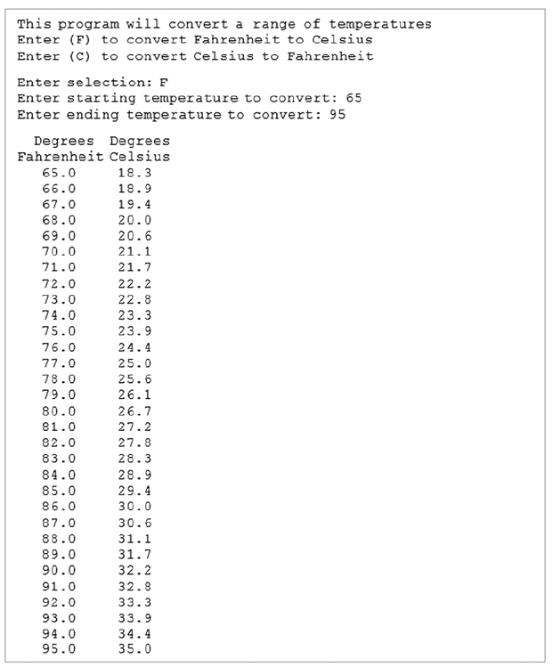
Temperature Conversion Program

Slide 10
Assignment : Temperature Conversion Program
def displayWelcome()
def getConvertTo()
def displayFahrenToCelsius(start,end)
def displayCelsiusToFahren(start,end)
def main()
call main()
A template is provided in the assignment.
Rename it before submission.

Slide 11
Project 1: create a text based game
Released: Lesson 6 (T1W10)
Due: Lesson 11 (T2W5)
Two paths:
Adventure RPG game (map creation, explore, tasks, win/lose game)
5 in 1 game (mini games: tic tac toe, melting snowman, etc)
Application of concepts:
Random
Data structure: list , tuple
String
Making decision
Game engine: while loop
Self defined functions

Slide 12
Project 1 : Text based Game
4 examples to show
Zork
http://textadventures.co.uk/games/play/5zyoqrsugeopel3ffhz_vq

Slide 13
Project 1: Deliverables
Documentation (.txt file) → use notepad or any other text editor
What is your game about ?
What are some challenges you face ?
How did you overcome it ?
Three Key Takeaways from this project.
Source file (.py file)
Comments are required for readability
Clear instructions for user
help function to help user ingame

Slide 14
Work to do . . .
Revision 3
Discussion Problem : tic tac toe
Temperature Conversion Program
Programming Assignment 6
Work on your Project 1

